Slide 1
Hypothesis testing
T-Tests and ANOVA

Slide 2
Difference of means
One sample test:
Do the sample mean and a designated (hypothesised) value differ statistically?
Two samples test:
Do the two samples means differ statistically?
More than two samples:
Are there any sample means that differ statistically from the rest?

Slide 3
Hypothesis tests
Two samples
More than two samples
ANOVA
Not equal variances
Welch t-test
Equal variances
Student t-test
One sample
One sample t-test
Difference of means (parametric tests)
These are all parametric tests – the sample data must be normally distributed.

Slide 4
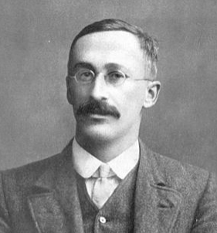
The t-test was invented by William Sealy Gossett (1876-1937) in 1908.
At the time, he was Head Experimental Brewer of Guinness. The original goal was to select the best barley grains from small samples, when the population standard deviation was not known.
Guinness didn’t want Gossett to reveal any industry secrets, which could be detrimental from a business point of view. However, they allowed him to publish his work under a different name.
Gossett used the pseudonym Student – hence the name Student’s t-test.
T-tests – a little history
William Sealy Gossett

Slide 5
The one sample t-test examines whether the mean of the sample is statistically different from a known or designated value. This value may be historical, coming from research, legal requirements, or industry standards.
Example: When manufacturing chocolate bars, the chocolate bar has to be a certain weight, e.g., 100g. A plant manager may want to test a random sample of chocolate bars to ensure that the machines are not under or over-weighing the chocolate bars.
One sample t-test

Slide 6
The independent two-sample t-test is used to compare the means of two different samples representing two different populations. There are two different tests of this kind applied to normally distributed data:
Student’s t-test, which assumes that the variances of the two samples are the same.
Welch's t test, which does not assume that the variances of the two samples are the same.
Example: When testing new drugs, the clinical trials use independent trial and control groups. The trial group takes the drug and the control group takes placebo.
Independent two sample t-test

Slide 7
Analysis of Variance (ANOVA) is used where a comparison has to be made between more than two population (sample) means.
ANOVA assumes that the data is normally distributed and the variances are the same although there are variants of the method that work with different variances.
Depending on the number of factors influencing the outcome of the test, there is one-way ANOVA, two-way ANOVA and multi-way ANOVA. We will only consider one-way ANOVA.
Examples:
Effect of the amount of study time on students’ results (several groups studying different times) – one-way ANOVA.
Effect of the amount of study time and music played while studying on students’ results (several groups studying different times and listening to different styles of music) – two-way ANOVA.
More than two samples –
ANOVA
Notes:
ANOVA tells you if the dependent variable changes according to the level of the independent variable. For example:
Your independent variable is social media use, and you assign groups to low, medium, and high levels of social media use to find out if there is a difference in hours of sleep per night.
Your independent variable is brand of soda, and you collect data on Coke, Pepsi, Sprite, and Fanta to find out if there is a difference in the price per 100ml.
You independent variable is type of fertilizer, and you treat crop fields with mixtures 1, 2 and 3 to find out if there is a difference in crop yield.
The null hypothesis (H₀) of ANOVA is that there is no difference among group means. The alternative hypothesis (H_{a}) is that at least one group differs significantly from the overall mean of the dependent variable.
If you only want to compare two groups, use a t test instead.

Slide 8
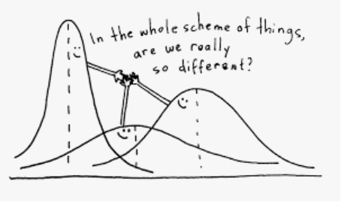
ANOVA cannot determine which specific samples are statistically significantly different from each other, only whether at least two samples are. To determine which specific samples are different, it is necessary to apply a post hoc test (e.g. Tukey’s Honestly Significant Difference (HSD) test).
More than two samples - anova
Notes:
ANOVA determines whether the groups created by the levels of the independent variable are statistically different by calculating whether the means of the treatment levels are different from the overall mean of the dependent variable.
If any of the group means is significantly different from the overall mean, then the null hypothesis is rejected.
ANOVA uses the F test for statistical significance. This allows for comparison of multiple means at once, because the error is calculated for the whole set of comparisons rather than for each individual two-way comparison (which would happen with a t test).
The F test compares the variance in each group mean from the overall group variance. If the variance within groups is smaller than the variance between groups, the F test will find a higher F value, and therefore a higher likelihood that the difference observed is real and not due to chance.

